Slide 1

Geometry
Unit 7, Lesson H1 Law of Sines Volume 1, pg. 427

Slide 2


Benchmark
MA.912.T.1.3
Apply the Law of Sines and the Law of Cosines to solve mathematical and real-world problems involving triangles.
volume 1, pg. 427

Slide 3
Integrated Mathematical Thinking and Reasoning Standards
MA.K12.MTR.1.1 Actively participate in effortful learning both individually and collectively.
MA.K12.MTR.2.1 Demonstrate understanding by representing problems in multiple ways.
MA.K12.MTR.4.1 Engage in discussions that reflect on the mathematical thinking of self and others.
MA.K12.MTR.5.1 Use patterns and structure to help understand and connect mathematical concepts.
MA.K12.MTR.7.1 Apply mathematics to real-world contexts.
volume 1, pg. 427

Slide 4

Learning Target
I can solve mathematical and real-world problems involving triangles using the Law of Sines.
volume 1, pg. 427

Slide 5

Warm-Up
volume 1, pg. 428

Slide 6
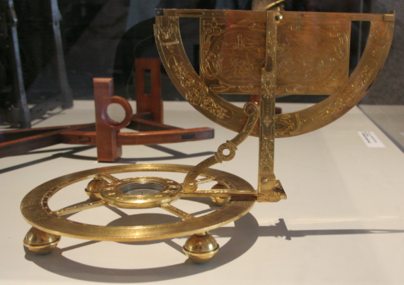
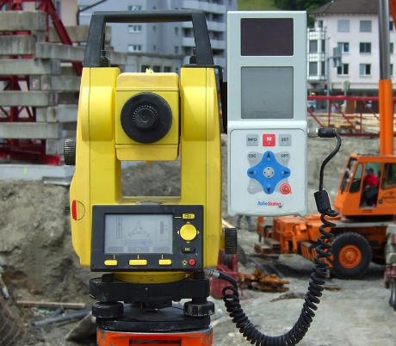
7.H1.1 Warm-Up: Notice and Wonder
A theodolite is an instrument used for measuring angles between designated visible points on the horizontal and vertical planes. Theodolites are often used for land surveying.
Late 16th century Theodolite | Modern Day Theodolite
volume 1, pg. 428

Slide 7
What do you notice?
What do you wonder?
volume 1, pg. 428

Slide 8

Collaboration
volume 1, pg. 428

Slide 9

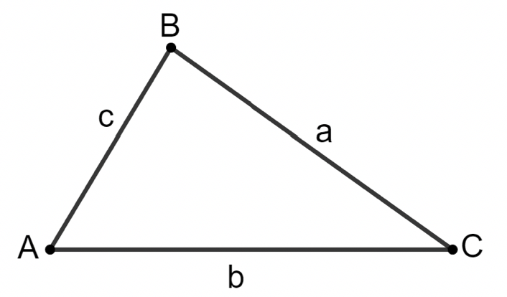
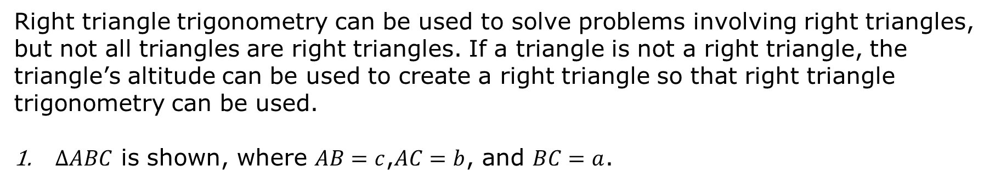
7.H1.2 Collaboration: Deriving the Formula for Law of Sines
Right triangle trigonometry can be used to solve problems involving right triangles, but not all triangles are right triangles. If a triangle is not a right triangle, the triangle’s altitude can be used to create a right triangle so that right triangle trigonometry can be used.
$∆ABC$ is shown, where $AB=c$,$AC=b$, and $BC=a$.
volume 1, pg. 428

Slide 10
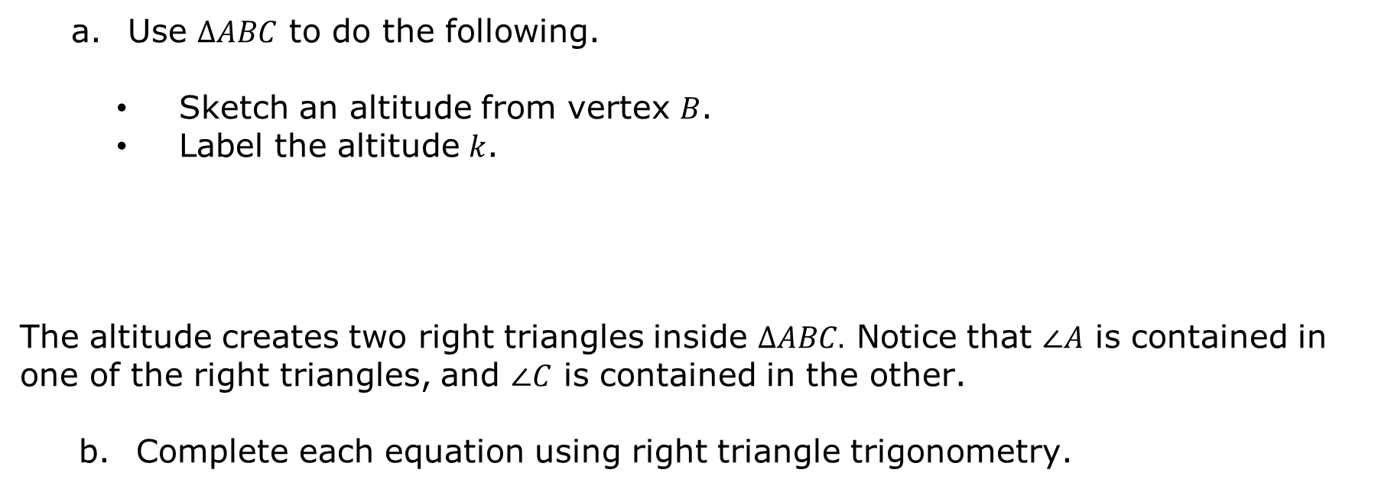
Use $∆ABC$ to do the following.
Sketch an altitude from vertex $B$.
Label the altitude $k$.
The altitude creates two right triangles inside $ΔABC.$ Notice that $∠A$ is contained in one of the right triangles, and $∠C$ is contained in the other.
Complete each equation using right triangle trigonometry.
$$sin \left(A\right)=$$ | $$sin \left(C\right)=$$
volume 1, pg. 428

Slide 11
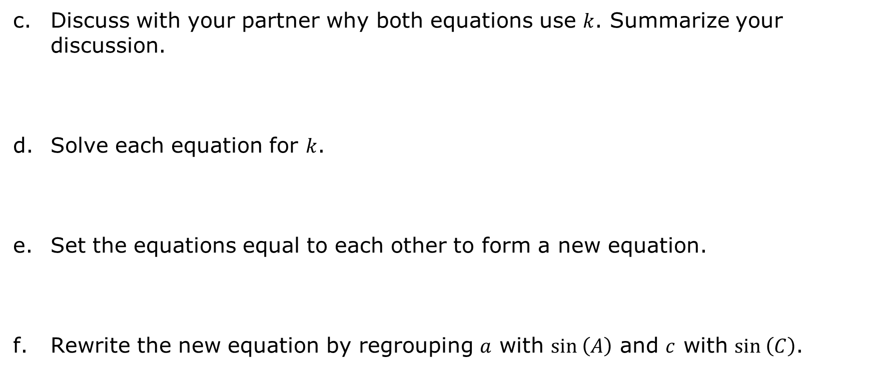
Discuss with your partner why both equations use $k$. Summarize your discussion.
Solve each equation for $k$.
Set the equations equal to each other to form a new equation.
Rewrite the new equation by regrouping $a$ with $sin \left(A\right)$ and $c$ with $sin \left(C\right)$.
volume 1, pg. 429

Slide 12
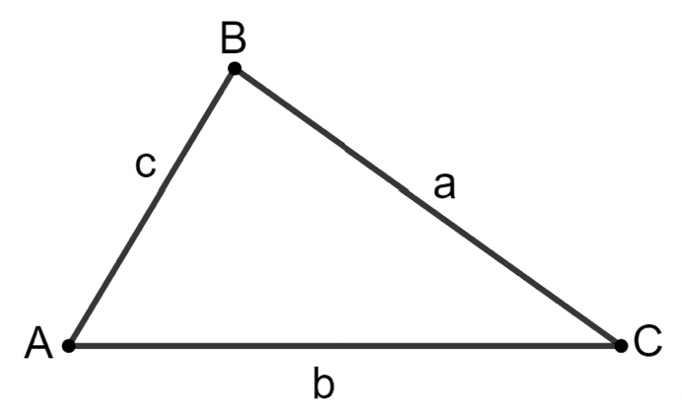

$∆ABC$ is shown where $AB=c$,$AC=b$, and $BC=a$.
Use $∆ABC$ to do the following.
Sketch an altitude from vertex $C$.
Label the altitude $k$.
volume 1, pg. 429

Slide 13
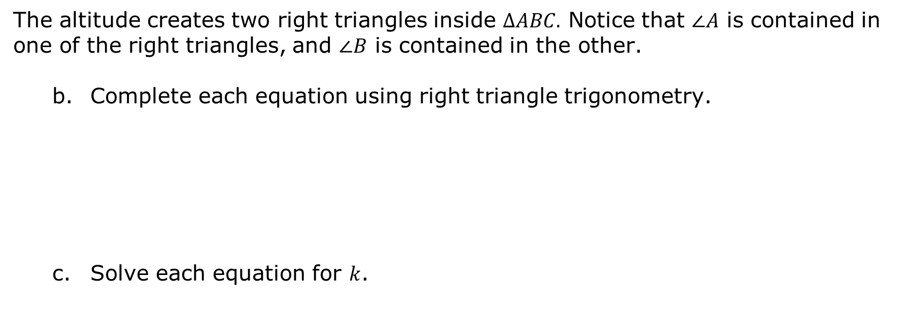
The altitude creates two right triangles inside $ΔABC.$ Notice that $∠A$ is contained in one of the right triangles, and $∠B$ is contained in the other.
Complete each equation using right triangle trigonometry.
Solve each equation for $k$.
$$sin \left(A\right)=$$ | $$sin \left(B\right)=$$
volume 1, pg. 429

Slide 14

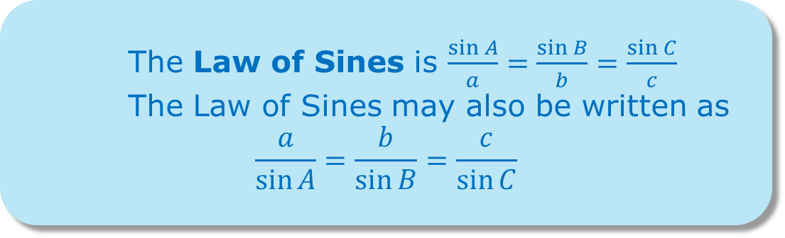
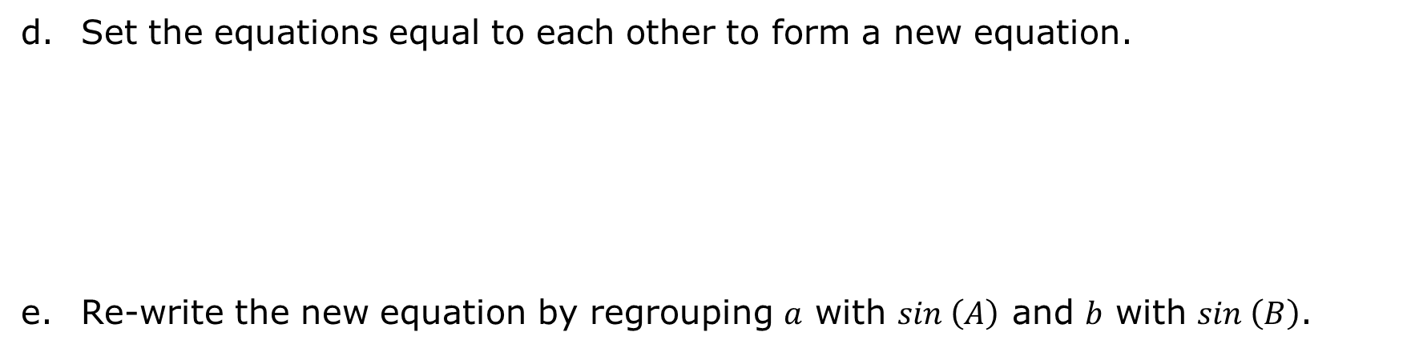
Set the equations equal to each other to form a new equation.
Re-write the new equation by regrouping $a$ with $sin \left(A\right)$ and $b$ with $sin \left(B\right)$.
The Law of Sines is $\frac{\sin{A}}{a}=\frac{\sin{B}}{b}=\frac{\sin{C}}{c}$
The Law of Sines may also be written as
$$\frac{a}{\sin{A}}=\frac{b}{\sin{B}}=\frac{c}{\sin{C}}$$
volume 1, pg. 430

Slide 15

Guided Instruction
volume 1, pg. 430

Slide 16
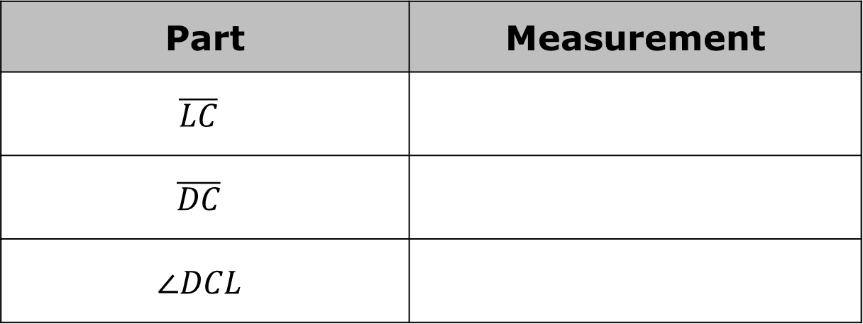
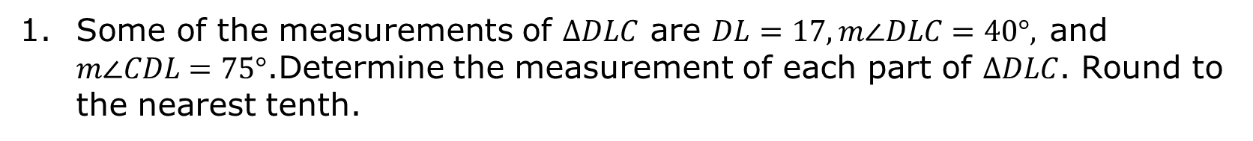
7.H1.3 Guided Instruction: Law of Sines
Some of the measurements of $∆DLC$ are $DL=17, m∠DLC=40°,$and $m∠CDL=75°$.Determine the measurement of each part of $∆DLC$. Round to the nearest tenth.
Part | Measurement
$$\overline{LC}$$
$$\overline{DC}$$
$$∠DCL$$
volume 1, pg. 430

Slide 17
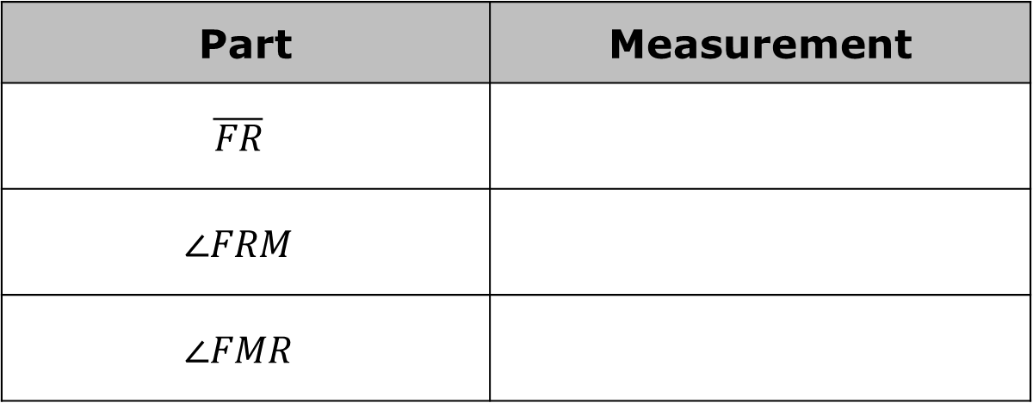
In $∆RFM$, $RM=66, FM=30,$ and $m∠RFM=26°$. Determine the measurement of each part of $∆RFM$. Round to the nearest tenth.
Part | Measurement
$$\overline{FR}$$
$$∠FRM$$
$$∠FMR$$
volume 1, pg. 431

Slide 18

Guided Practice
volume 1, pg. 431

Slide 19

7.H1.4 Guided Practice: Law of Sines
$∆LVY$ has side measurements of $VY=8.5$and $LY=16.5$. The measure of $∠LVY$ is $84°$. Find all missing sides and angles. Round to the nearest tenth.
volume 1, pg. 431

Slide 20
The three known measurements of $∆DNH$ are$DN=26$, $m∠NDH=80°$, and $m∠DNH=75°$. Find all missing sides and angles. Round to the nearest tenth.
volume 1, pg. 432

Slide 21

Your Turn
volume 1, pg. 432

Slide 22
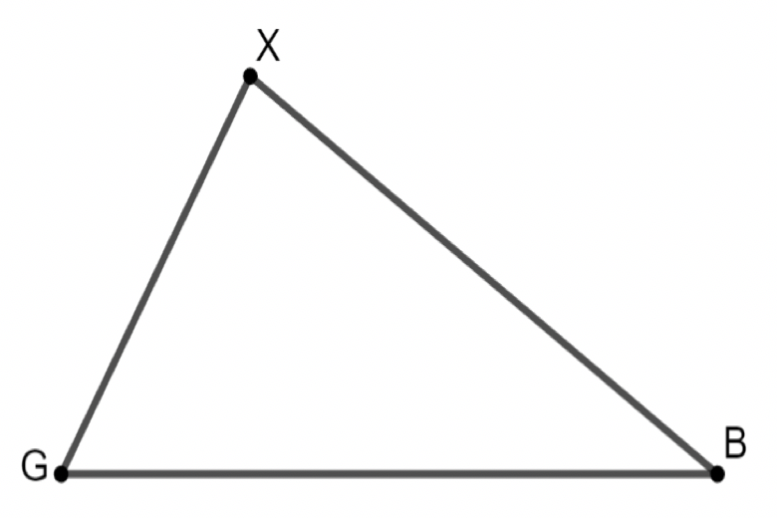
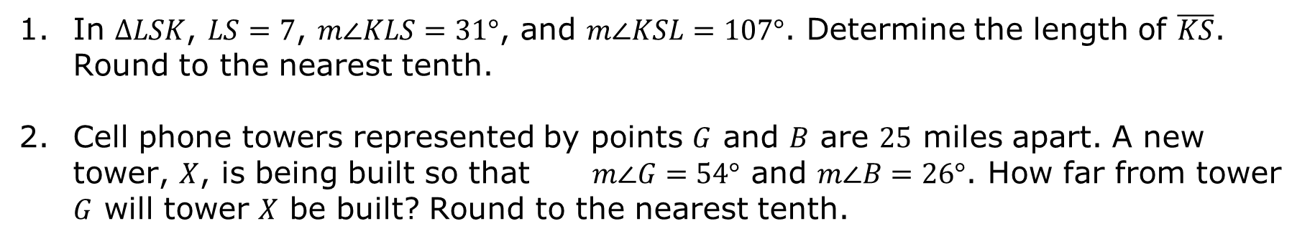
7.H1.5 Your Turn!
In $∆LSK$, $LS=7$, $m∠KLS=31°$, and $m∠KSL=107°$. Determine the length of $\overline{KS}$. Round to the nearest tenth.
Cell phone towers represented by points $G$ and $B$ are $25$ miles apart. A new tower, $X$, is being built so that $m∠G=54°$ and $m∠B=26°$. How far from tower $G$ will tower $X$ be built? Round to the nearest tenth.
volume 1, pg. 432

Slide 23

Wrap-Up
volume 1, pg. 433

Slide 24
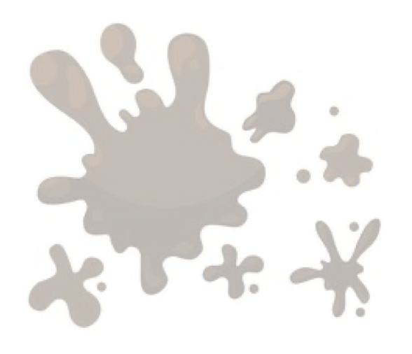
7.H1.6 Wrap-Up: Reflection
What was the muddiest (most difficult or confusing) point in today’s lesson on the Law of Sines?
volume 1, pg. 433

